Slide 1
COS 30049 Computing Technology Innovation Project
Week4: Machine Learning Project Lifecycle Introduction
Hao Zhang
hzhang1@swin.edu.au

Slide 2
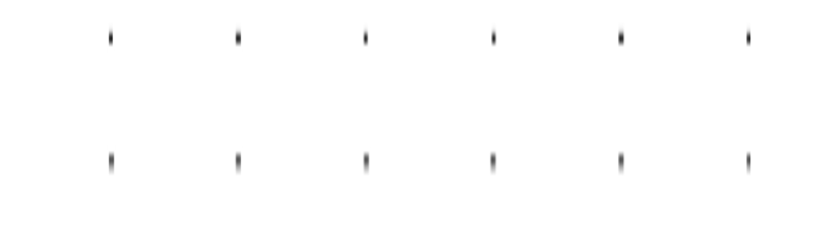

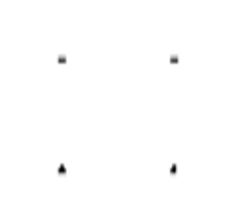

Acknowledgement of Country
We respectfully acknowledge the Wurundjeri People of the Kulin Nation, who are the Traditional Owners of the land on which Swinburne’s Australian campuses are located in Melbourne’s east and outer-east, and pay our respect to their Elders past, present and emerging.
We are honoured to recognise our connection to Wurundjeri Country, history, culture, and spirituality through these locations, and strive to ensure that we operate in a manner that respects and honours the Elders and Ancestors of these lands.
We also respectfully acknowledge Swinburne’s Aboriginal and Torres Strait Islander staff, students, alumni, partners and visitors.
We also acknowledge and respect the Traditional Owners of lands across Australia, their Elders, Ancestors, cultures, and heritage, and recognise the continuing sovereignties of all Aboriginal and Torres Strait Islander Nations.

Slide 3
Objectives: 1. Basics of Machine Learning 2. Understand what is machine learning lifecycle 3. Define project objectives and translate them into machine learning problems (tasks) 4. Delve into data processing in detail

Slide 4
Basics of Machine Learning
Machine learning (ML) is a branch of artificial intelligence (AI) and computer science that focuses on the using data and algorithms to enable AI to imitate the way that humans learn, gradually improving its accuracy.
In machine learning, computers apply statistical learning techniques to automatically identify patterns in data. These techniques can be used to make highly accurate predictions.

Slide 5
Basics of Machine Learning
Different types of Machine Learning:
Supervised Learning: In supervised learning, the model is trained on labeled data, meaning each input comes with a corresponding output. The goal is for the model to learn the mapping from inputs to outputs so that it can predict the output for new, unseen data. Common tasks include classification and regression.
Unsupervised Learning: In unsupervised learning, the model is trained on unlabeled data, where the algorithm tries to identify patterns or structure in the data without specific output labels. Common tasks include clustering and dimensionality reduction.

Slide 6
Basics of Machine Learning
Different types of Machine Learning:
Semi-supervised learning: The dataset contains structured and unstructured data, which guides the algorithm on its way to making independent conclusions. The combination of the two data types in one training dataset allows machine learning algorithms to learn to label unlabeled data.
Reinforcement learning: The dataset uses a “rewards/punishments” system, offering feedback to the algorithm to learn from its own experiences by trial and error.
In this unit, we will only focus on Supervised Learning and Unsupervised Learning.

Slide 7
Machine Learning Lifecycle
The ML lifecycle is a cyclic, iterative process that outlines best practices and guidelines for each phase of developing a machine learning workload. It provides clarity and structure, ensuring the success of a machine learning project.
Project Goal
ML Problem Framing
Project Goal Identification:
People Implementing ML should have a well-defined understanding of the problem they aim to solve and the value that solving this problem could bring. In this phrase, you will need to set your objective, and your metrics. For your project, it's essential to clearly identify the problem you have in mind and the outcomes you want to achieve.
ML Problem Framing: In this phase, the project’s problem is translated into a machine learning context: identifying what data will be observed and what needs to be predicted (commonly referred to as the label or target variable).
Data Processing
Model Selection
& Development
Deployment
Monitoring

Slide 8
Machine Learning Lifecycle
Project Goal
Data processing
Training an accurate ML model requires data processing to convert data into a usable format.
Data processing steps include collecting data, preparing data, and feature engineering that is the process of creating, transforming, extracting, and selecting variables from data.
Model selection and development
Model development consists of model building, training, tuning, and evaluation. The details of this part will be introduced in week 6-7.
ML Problem Framing
Data Processing
Model Selection
& Development
Deployment
Monitoring

Slide 9
Machine Learning Lifecycle
Project Goal
Deployment
After a model is trained, tuned, evaluated and validated, you can deploy the model into production. You can use the model to make predictions and inferences.
Monitoring
Model monitoring system ensures your model is maintaining a desired level of performance through early detection and mitigation.
ML Problem Framing
Data Processing
Model Selection
& Development
Deployment
Monitoring

Slide 10
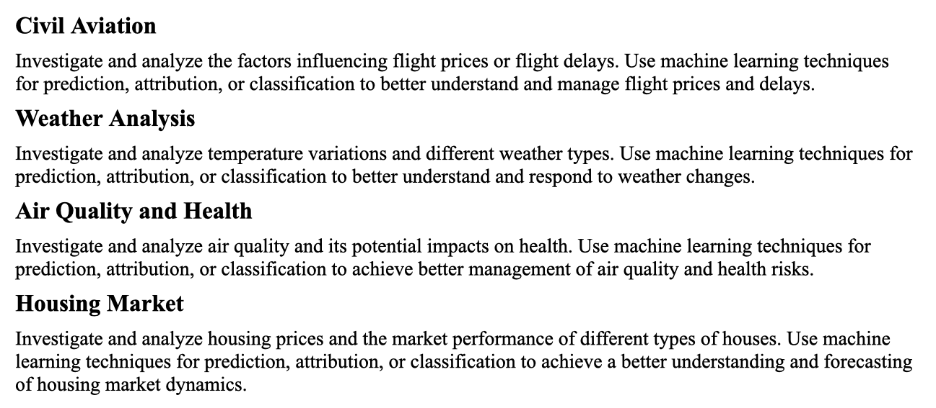
Project Problem
Choose Your Topic
Select one of the four topics that interests you the most.

Slide 11
Project Problem/Goal
Define the Problem/Goal
Identify a specific problem within your chosen topic that you want to address.
Formulate a clear and concise problem statement.
For example, Based on nearly ten years of existing housing price data in Melbourne, the following project problem can be set:
Housing Price Trend Prediction
Analyze the housing price data from the past ten years to predict future price trends in different areas, helping buyers and investors make more informed decisions.

Slide 12
Project Goal
The following work steps should be followed to establish your project goals.
• Understand project requirements.
• Form a project question.
• Identify critical, must-have features.
• Consider new project processes that might come out of this implementation.
• Consider how project value can be measured using metrics that the ML model can help to improve.

Slide 13
ML Problem Framing
Problem framing is the process of analyzing a problem to isolate the individual elements that need to be addressed to solve it. Problem framing helps determine your project's technical feasibility and provides a clear set of goals and success criteria. When considering an ML solution, effective problem framing can determine whether your product ultimately succeeds.
Some view ML as a universal tool that can be applied to all problems. In reality, ML is a specialized tool suitable only for particular problems.
ML systems can be divided into two broad categories: predictive ML and generative AI. In this unit, we only learn and use predictive ML.
At a high level, ML problem framing consists of two distinct steps:
Determining whether ML is the right approach for solving a problem.
Framing the problem in ML terms.

Slide 14
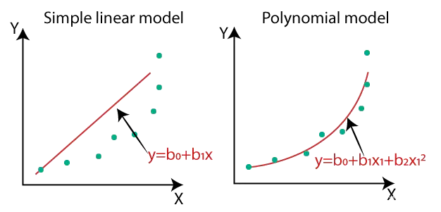
ML Problem Framing
Machine learning can solve different types of problems:
Regression
Regression problems involve predicting the future values of continuous numerical variables.
For example, housing price prediction, stock price prediction, weather forecasting, etc.

Slide 15
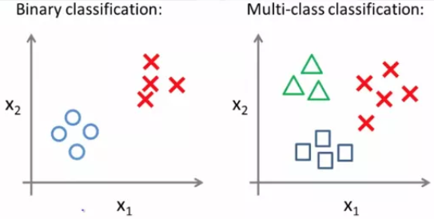
ML Problem Framing
Classification
Classification problems involve categorizing data into different classes. For example, spam filtering (classifying emails as spam or non-spam), image classification (classifying images as cats, dogs, etc.), disease diagnosis (classifying patients into different disease types), etc.

Slide 16
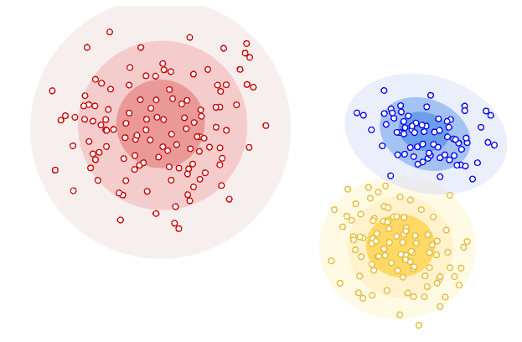
ML Problem Framing
Clustering
Clustering problems involve grouping data into different groups or clusters. For example, customer segmentation (grouping customers based on their behavior), image segmentation (dividing an image into different regions), etc.

Slide 17
ML Problem Framing
Refine Project Objectives
First, analyze in detail what the project's goals are.
Do you need to predict a continuous value?
Do you need to classify data into different categories?
Do you need to discover hidden patterns or groupings in the data?
Examples:
Suppose you are working with a dataset that includes patient information from a healthcare system. The dataset is complex and includes both categorical and numeric features. You want to find patterns and similarities in the dataset. How might you approach this task?
A company wants to group its customers into segments based on their purchasing behavior (e.g., spending patterns and frequency of purchases). The goal is to find natural groupings within the customer base that were not previously defined.

Slide 18
ML Problem Framing
Understand the Nature of the Data
Briefly review and analyze the data for the chosen topic.
Is the data continuous or discrete?
Does the data have labels (known outputs)?
How large is the dataset?
What are the number and types of features in the data?
Choose the type of ML problem
Classification？
Regression？
Clustering？

Slide 19
Data Processing
Data processing is a broad concept that involves performing various operations on data to extract useful information. These operations include, but are not limited to:
Data Collection: Gathering raw data from various sources.
Data Cleaning: Removing or correcting errors, missing values, or inconsistent data.
Data Transformation: Converting data from one format or structure to another.
Data Reduction: Reducing the volume of data through aggregation or filtering while retaining important information.
Data Analysis: Applying statistical methods and algorithms to analyze data and derive conclusions or identify patterns.

Slide 20
Data Processing
Data Collection
Data is the driving force of predictive ML. To make good predictions, you need data that contains features with predictive power.
Your data should have the following characteristics:
Abundant. The more relevant and useful examples in your dataset, the better your model will be.
Consistent and reliable. Having data that's consistently and reliably collected will produce a better model. For example, an ML-based weather model will benefit from data gathered over many years from the same reliable instruments.
Trusted. Understand where your data will come from. Will the data be from trusted sources you control, like logs from your product, or will it be from sources you don't have much insight into, like the output from another ML system?

Slide 21
Data Processing
Data Collection
Your data should have the following characteristics:
Available. Make sure all inputs are available at prediction time in the correct format. If it will be difficult to obtain certain feature values at prediction time, omit those features from your datasets.
Correct. In large datasets, it's inevitable that some labels will have incorrect values, but if more than a small percentage of labels are incorrect, the model will produce poor predictions.
Representative. The datasets should be as representative of the real world as possible. In other words, the datasets should accurately reflect the events, user behaviors, and/or the phenomena of the real world being modeled. Training on unrepresentative datasets can cause poor performance when the model is asked to make real-world predictions.
If you can't get the data you need in the required format, your model will make poor predictions.

Slide 22
Data Processing
Data Collection
Data Collection Methods
Surveys: Use questionnaires to collect data online or offline.
Experiments: Design and conduct experiments to collect data by controlling variables.
Interviews: Conduct in-depth interviews via face-to-face, phone, or video.
Web Scraping: Use automated scripts to scrape data from websites.
Sensor Data/Log Data: Collect data using various sensors like temperature sensors, motion sensors, GPS, etc.; Collect data from server, application, or website logs.
Public Datasets Use publicly available datasets from governments, research institutions, or companies. Sources: Kaggle, UCI Machine Learning Repository, government data portals.

Slide 23
Data Processing
Data Collection
Data Sources
Internet and Social Media: Collect data via APIs or web scraping from internet and social media platforms. Sources: Twitter API, Facebook Graph API, Instagram API.
Government and Public Institutions: Access public data released by governments and public institutions. Sources: data.gov, EU Open Data Portal, World Bank Data.
Research and Academic Institutions: Use datasets published by research and academic institutions. Sources: UCI Machine Learning Repository, Kaggle, IEEE DataPort.
Companies and Enterprises: Internal business data or data from partners. Sources: company databases, CRM systems, ERP systems.
Market Research Firms: Purchase or subscribe to data and reports from market research firms. Sources: Nielsen, Gartner, Forrsteer.

Slide 24
Data Processing
Data Cleaning
1. Handling Missing Values
Deleting Missing Values: If the proportion of missing values is small, consider deleting records that contain missing values.
Imputing Missing Values: Use statistical methods such as mean, median, mode, or other techniques to fill in missing values.
Interpolation: Use interpolation methods, such as linear interpolation, to fill in missing values.
2. Handling Duplicate Values
Deleting Duplicate Values: Check for and delete duplicate records in the dataset.
3. Handling Outliers
Box Plot Method: Use box plots to identify and handle outliers.
Z-Score Method: Identify and handle outliers by calculating the Z-score.

Slide 25
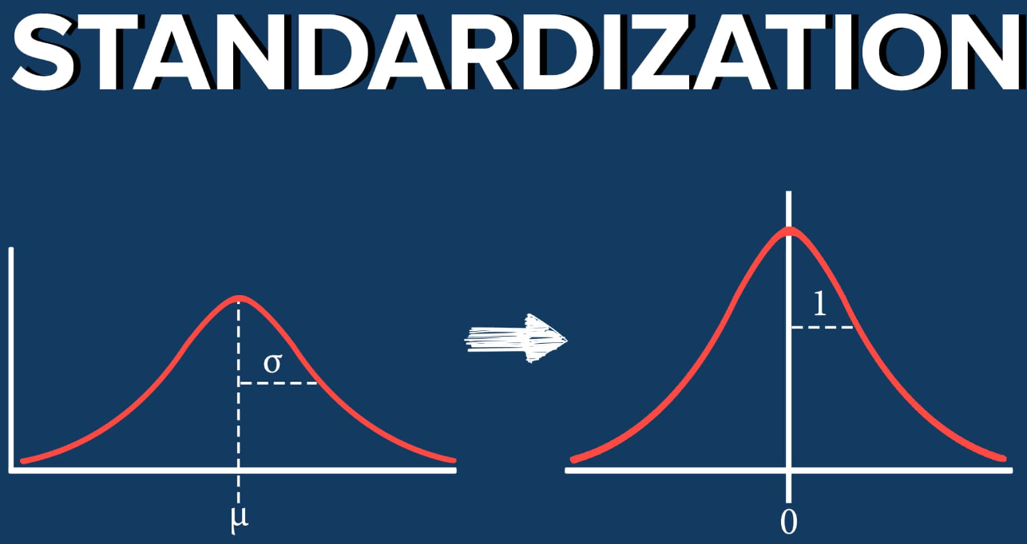

Data Processing
Data Transformation
1. Standardization: Converts features to have a mean of 0 and a standard deviation of 1.
Use Case: Suitable for features with different scales, like in neural networks and linear regression.

Slide 26
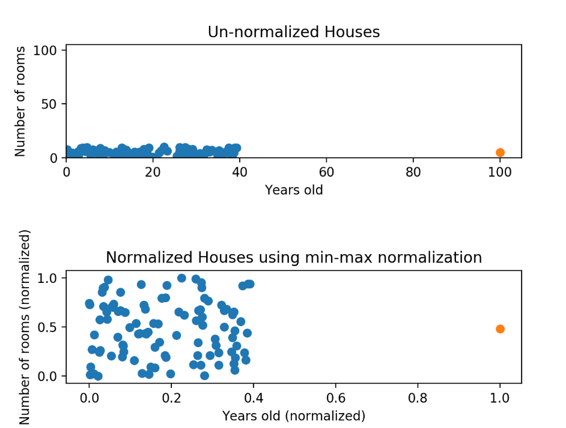

Data Processing
Data Transformation
2. Normalization: Scales features to a specific range, usually [0, 1].
Use Case: When features need to be on the same scale, such as in KNN and clustering algorithms.

Slide 27

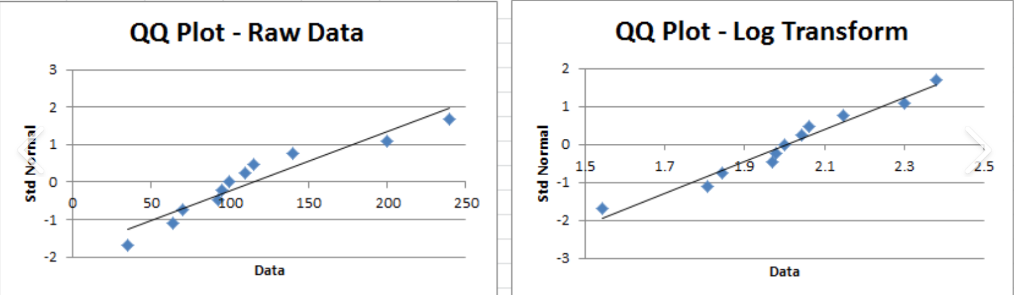
Data Processing
Data Transformation
3. Log Transformation: Converts skewed data into a more normal distribution. Use Case: Suitable for data with exponential growth or multiplicative effects.

Slide 28

Data Processing
Data Transformation
4. Mean Deviation Transformation Centers data by subtracting the mean from each data point. Use Case: To remove mean shift and center data distribution.

Slide 29
Data Processing
Data Transformation
Transformation Method | Definition | Applicable Algorithms | Characteristics | Use Cases
Standardization | Adjusts data to have a mean of 0 and a standard deviation of 1, so features are on a similar scale. | K-Means, SVM, Linear Regression | Ensures features are comparable in scale; sensitive to outliers. | When features have different units or scales, and you need to compare them directly.
Normalization | Scales data to a fixed range, usually [0, 1] or [-1, 1], making all data fit within the same range. | Neural Networks (e.g., Deep Learning), KNN | Compresses data to the same range; ideal for algorithms sensitive to input scale. | When the input features have different ranges, and the model (like neural networks) requires data within a specific range.
Log Transformation | Applies a logarithm to data to reduce the impact of large values, making differences more manageable. | Linear Regression, Decision Trees | Reduces the effect of large values and skewness; not suitable for negative or zero values. | When data is highly skewed, such as income data, where large values dominate.
Mean Deviation Transformation | Shifts data around its mean, centering it at 0, which helps in identifying variations. | Time Series Analysis, Signal Processing | Centers data around the mean; useful for removing overall trends or shifts while retaining the original shape of data. | When you need to analyse data deviations from the mean, such as in signal processing or removing trends in time series data.

Slide 30
Data Processing
Data Splitting
Training Set: A dataset used to train the model. The model learns the relationships between features and labels in the training data, adjusting its parameters to correctly predict unknown data.
Validation Set: A dataset used during training to evaluate the model's performance. It helps in tuning hyperparameters and selecting the best model, preventing overfitting.
Test Set: A dataset used for the final evaluation of the model's performance. It is completely independent, and the model's performance on the test set represents its expected effectiveness in real applications.
Why we need splitting?
Evaluating Model Performance: The test set is independent of the training process and is used to assess the model's performance on unseen data, thereby determining its generalization ability.
Improving Model Reliability: This three-way split allows for a more accurate assessment of the model's actual performance, ensuring that it performs well in real-world applications.

Slide 31
Data Processing
Data Splitting
How to Split Train-Test
Steps:
Divide the Dataset: Comm on ratios are 70:30 or 80:20, meaning 70% or 80% of the data is used for training, and the remaining 30% or 20% is used for testing.
Train the Model: Use the training set to train the machine learning model.
Evaluate the Model: Use the test set to evaluate the performance of the model.

Slide 32
Data Processing
Data Splitting – Additional knowledge
Cross-Validation
Purpose: To reduce bias in model evaluation and obtain a more stable and reliable performance assessment through multiple splits and training iterations.
Steps:
Select a Cross-Validation Method:
k-Fold Cross-Validation: Divide the dataset into k subsets and iterate k times, using k-1 subsets for training and the remaining 1 subset for testing each time.
Leave-One-Out Cross-Validation (LOOCV): Train the model on n-1 samples and test on the remaining 1 sample, repeating this for all samples.
Compute Average Performance:
Calculate the average performance metrics (e.g., accuracy, mean squared error) across all iterations.

Slide 33
Have a Break and Move to Lecture 02

